Slide 1
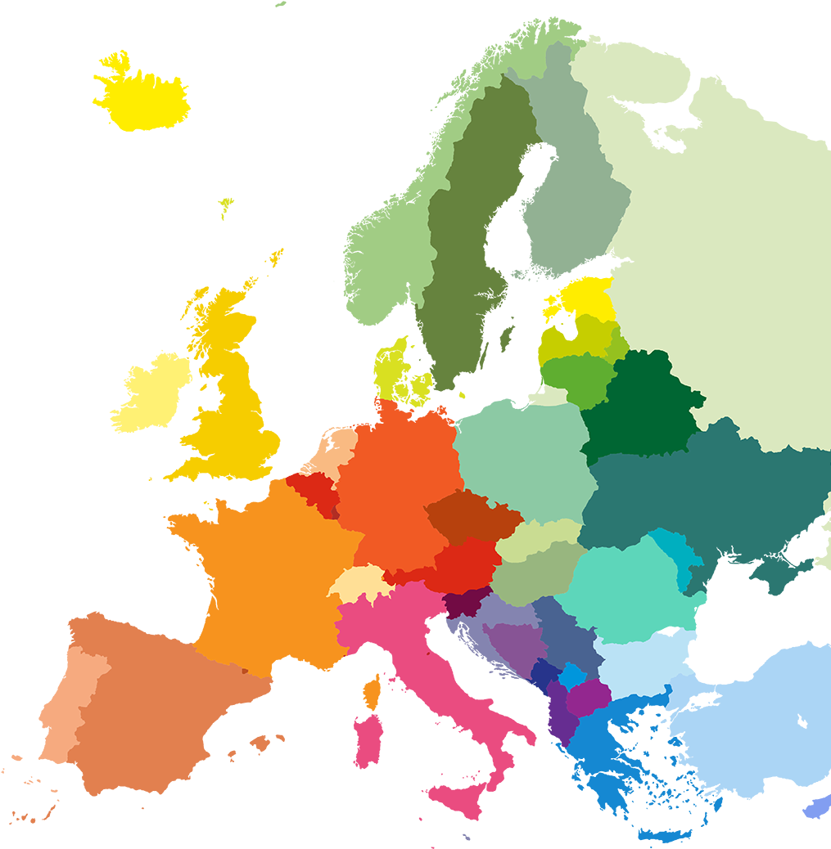
Enache Maria-Ianina
Puscasu Tudor
FILS - CTI
1211EC
EUROPLE
Coord teacher
sl. dr. ing. Mitrea Dan Alexandru

Slide 2

Contents
Programming Languages that we used
Similar applications
What is new. What we improved
Objectives
Features. Advantages. Disadvantages
Future plans

Slide 3



I. Programming Languages and frameworks that we used
Our web application is built using a combination of HTML, JavaScript, SQL, CSS, and Bootstrap. To visualize geographic data on our map, we utilize the GeoJSON data format, which allows us to encode and display geographical information. The map is rendered using the Leaflet JavaScript library, allowing the user to zoom in and move around within the European bounds.

Slide 4
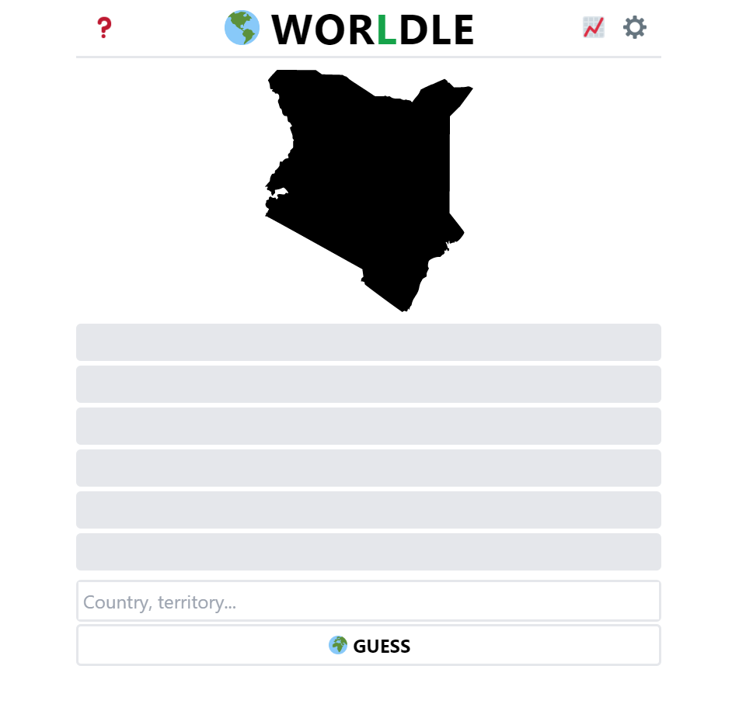
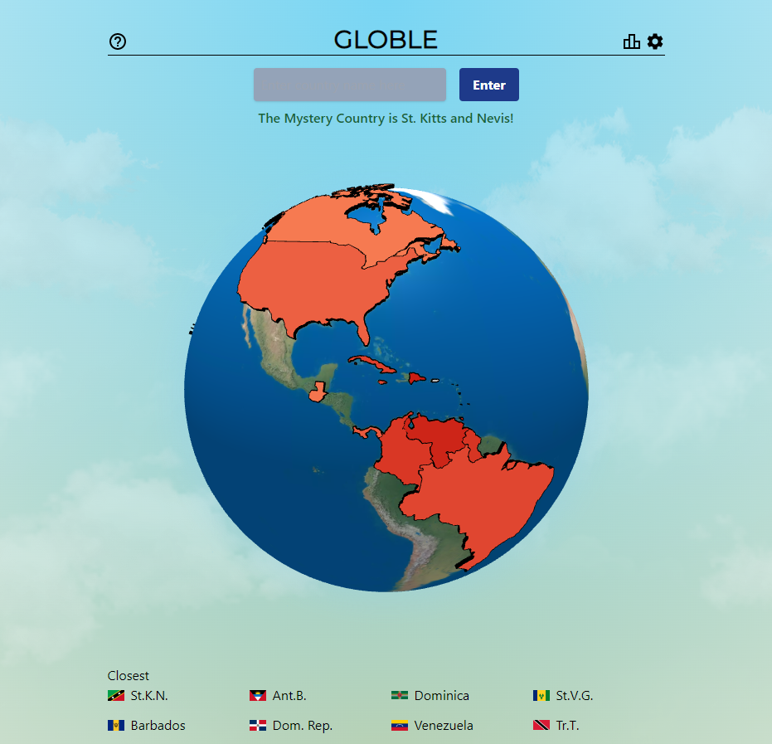
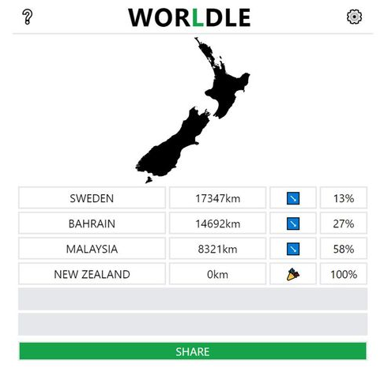
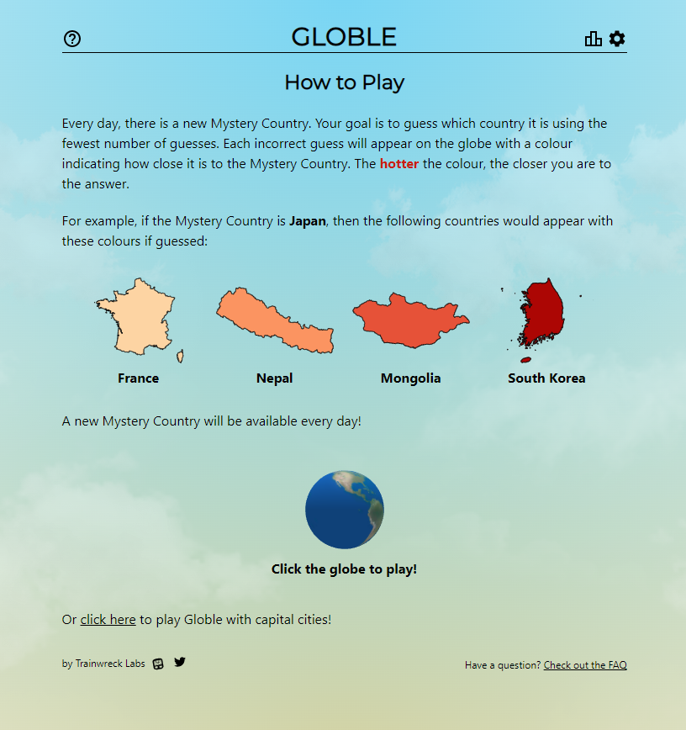
II. Similar applications
In Worldle, the gameplay revolves around guessing the country by its shape within a given number of attempts. There are direction indicators to help the user locate the country.
Globle implements a "hot and cold" system, with an unlimited number of guesses and the absence of direction indicators. Players rely on the feedback of "hot" or "cold" to guide their search.
Similar apps to ours include geography related variations of the famous Wordle game, such as Worldle and Globle.
Our application uniquely combines elements from both of these games, blending their aesthetics and gameplay mechanics.

Slide 5
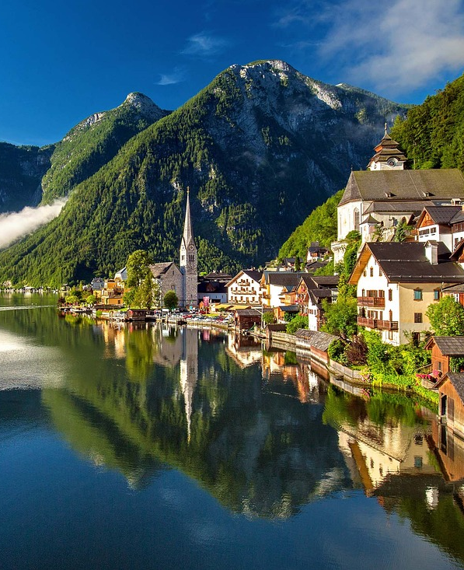
III. What is new. What we improved
Our application’s new feature is that it only focuses on Europe, making it easier for users to guess thanks to reduced distances and better knowledge of the continent as opposed to the whole world.
By combining the key elements of both Worldle and Globle, our app integrates the engaging "hot and cold" mechanism alongside direction indicators and a limited number of guesses.
The app’s main improvement is that it is unlimited, allowing the player to try to guess as many times as they wish, as opposed to Worldle and Globle, where users are limited to a single country per day.

Slide 6

Provide entertainment and educational value for geography enthusiasts and individuals seeking to practice and enhance their knowledge of European geography.
Create a user-friendly experience with the hot and cold feature, catering to beginners and facilitating their engagement with the game.
Encourage learning by challenging users to guess European country names, thus familiarizing themselves with their spellings and locations.
Present a unique version of the popular wordle game genre, inspired by our own passion for such games.
IV. Objectives

Slide 7
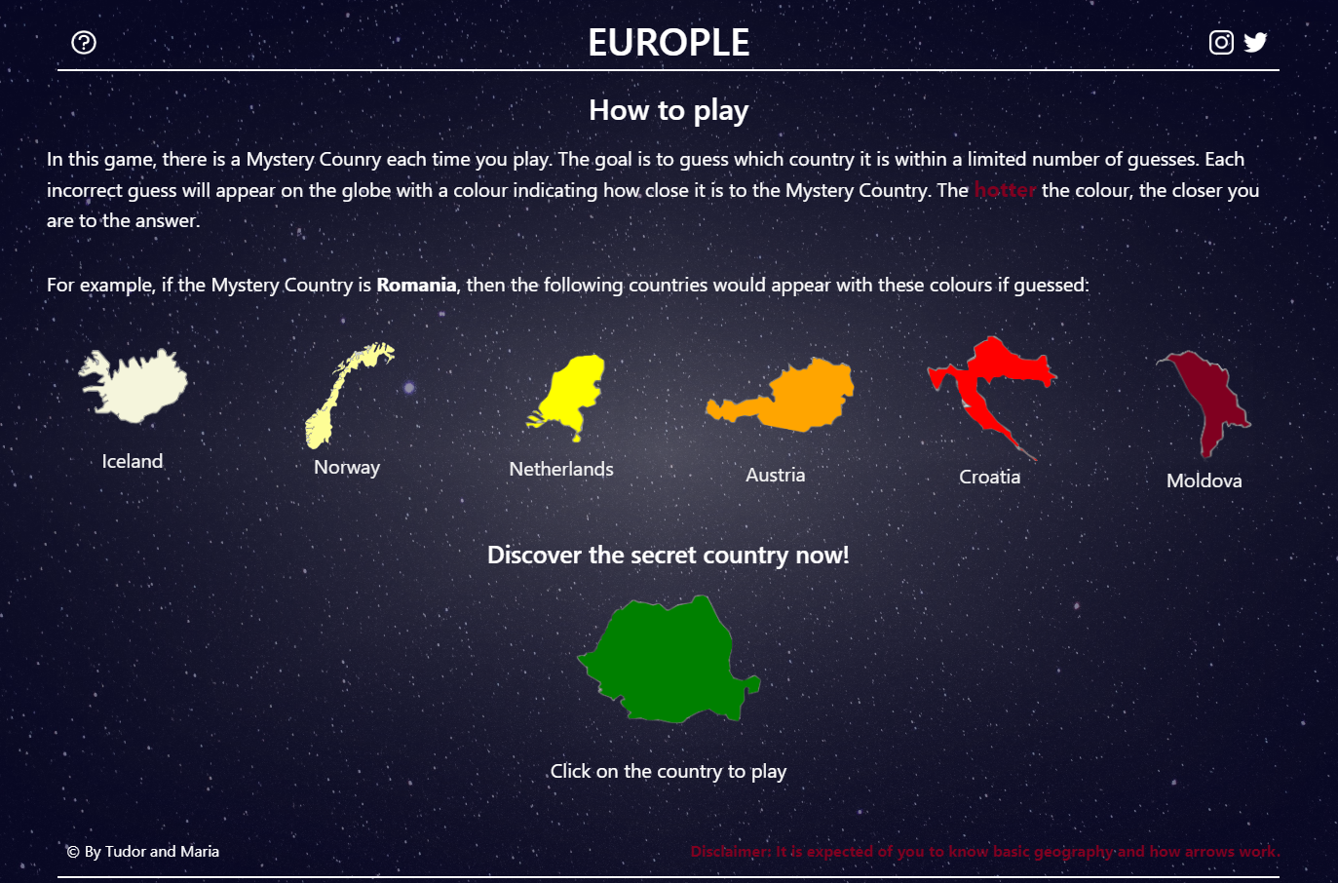
V. Features. Advantages. Disadvantages
The home page offers instructions on how to play the game, as well as visual indicators that explain the game mechanic.
The player can then click on the correct country from the example (Romania) to begin playing.

Slide 8
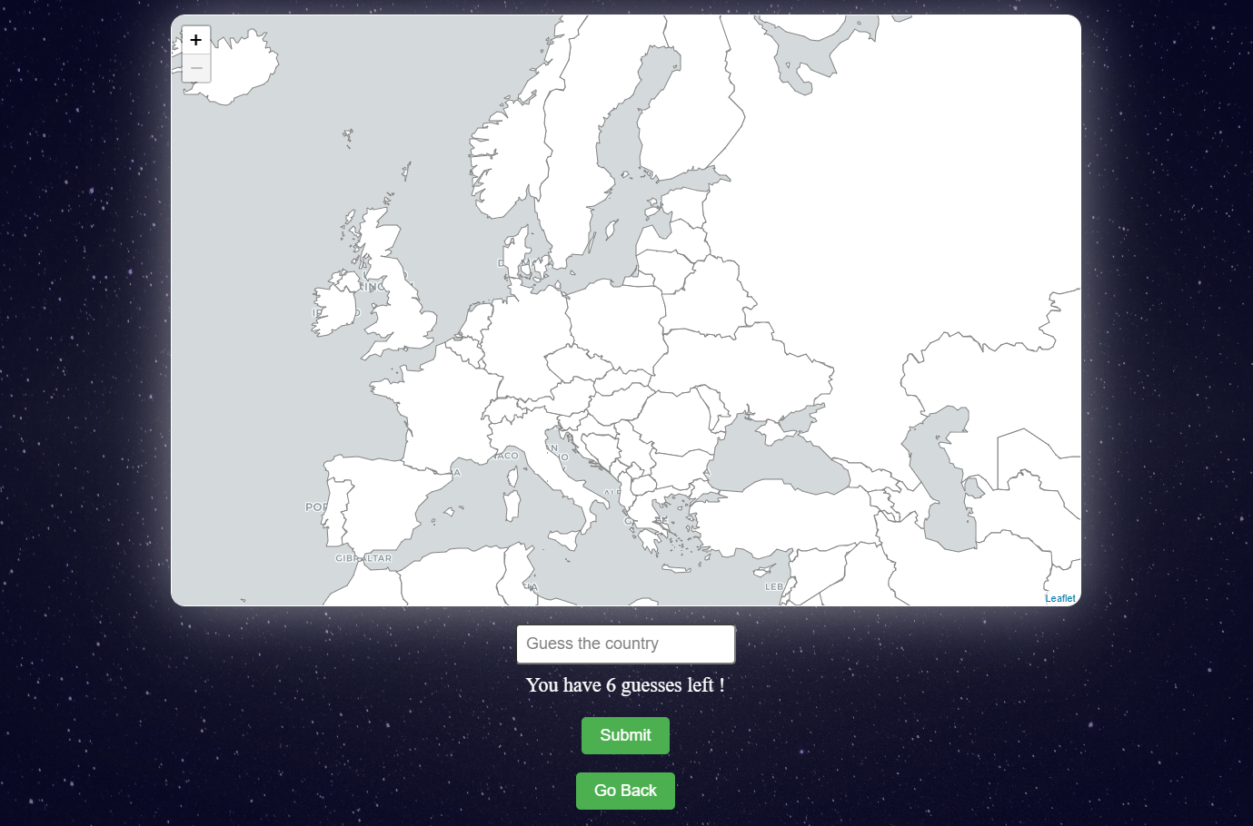
The main game page offers the interactive map and an input field for guesses. Start by typing a country, which will be coloured accordingly and added to a table.
The guess number is updated as the player makes their guesses and the game stops if the country isn’t found within the limit.

Slide 9
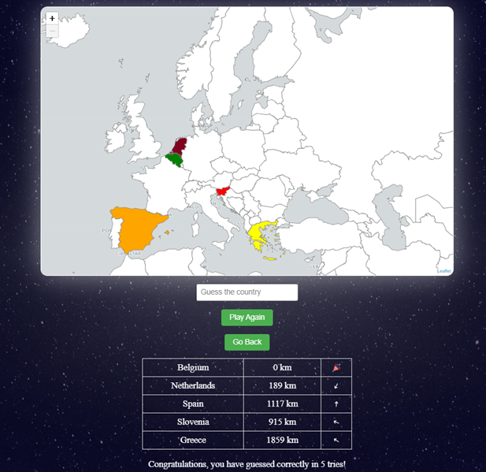
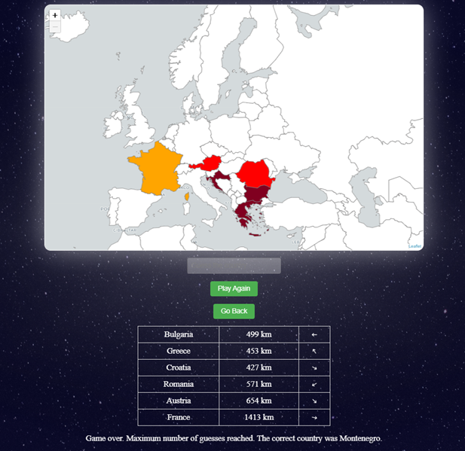
Full list of features:
Leaflet interactive map with a GeoJSON layer to help change the colour of the countries
Hot-cold feature
Map bounds, can’t move to another region
Connection with the MySQL database to retrieve the name, latitude and longitude to calculate the distance
Guesses table with the distance to the correct country and a direction arrow
Updating number of guesses left
Congratulations message
If the player couldn’t guess, the correct country is displayed
Example of a played game
Example of a game over

Slide 10

Advantages:
Educational Value: The game can serve as an interactive learning tool, helping users improve their knowledge of European countries, their names, and their locations.
Entertainment and Engagement: The game provides an enjoyable and addictive experience, keeping users engaged and entertained while they play and learn.
Application Mechanics: The game mechanics are designed to be accessible and easily understood by players of all age groups, ensuring that everyone can enjoy the game.
Disadvantages:
Limited Gameplay Variability: Users may eventually encounter repetitive gameplay patterns, leading to potential boredom or decreased interest over time.
Compatibility Issues: The web app is not yet compatible with all web browsers or devices, which could limit the potential user base.
Gameplay: The gameplay is not without flaw. The distance is calculated from the coordinates at the center of the countries, as opposed to closest borders, so long distances may affect the colouring.

Slide 11

VI. Future plans
Encrypting the correct country in the console
Predictive text to make typing easier
User stats
Settings page (more page themes)
Implement cookies

Slide 12

Conclusion
In conclusion, our web application combines education and entertainment to create a compelling Wordle game focused on European countries. By striving for continuous improvement and providing an impactful learning experience, we aim to engage users and establish a strong and satisfied user base.

Slide 13

Thank you for your attention!

